Slide 1
SYP 2026 Elections
Rhea-Leigh Hardie
Candiate for Edinburgh Eastern. Tranent and Mussselburgh

Slide 2
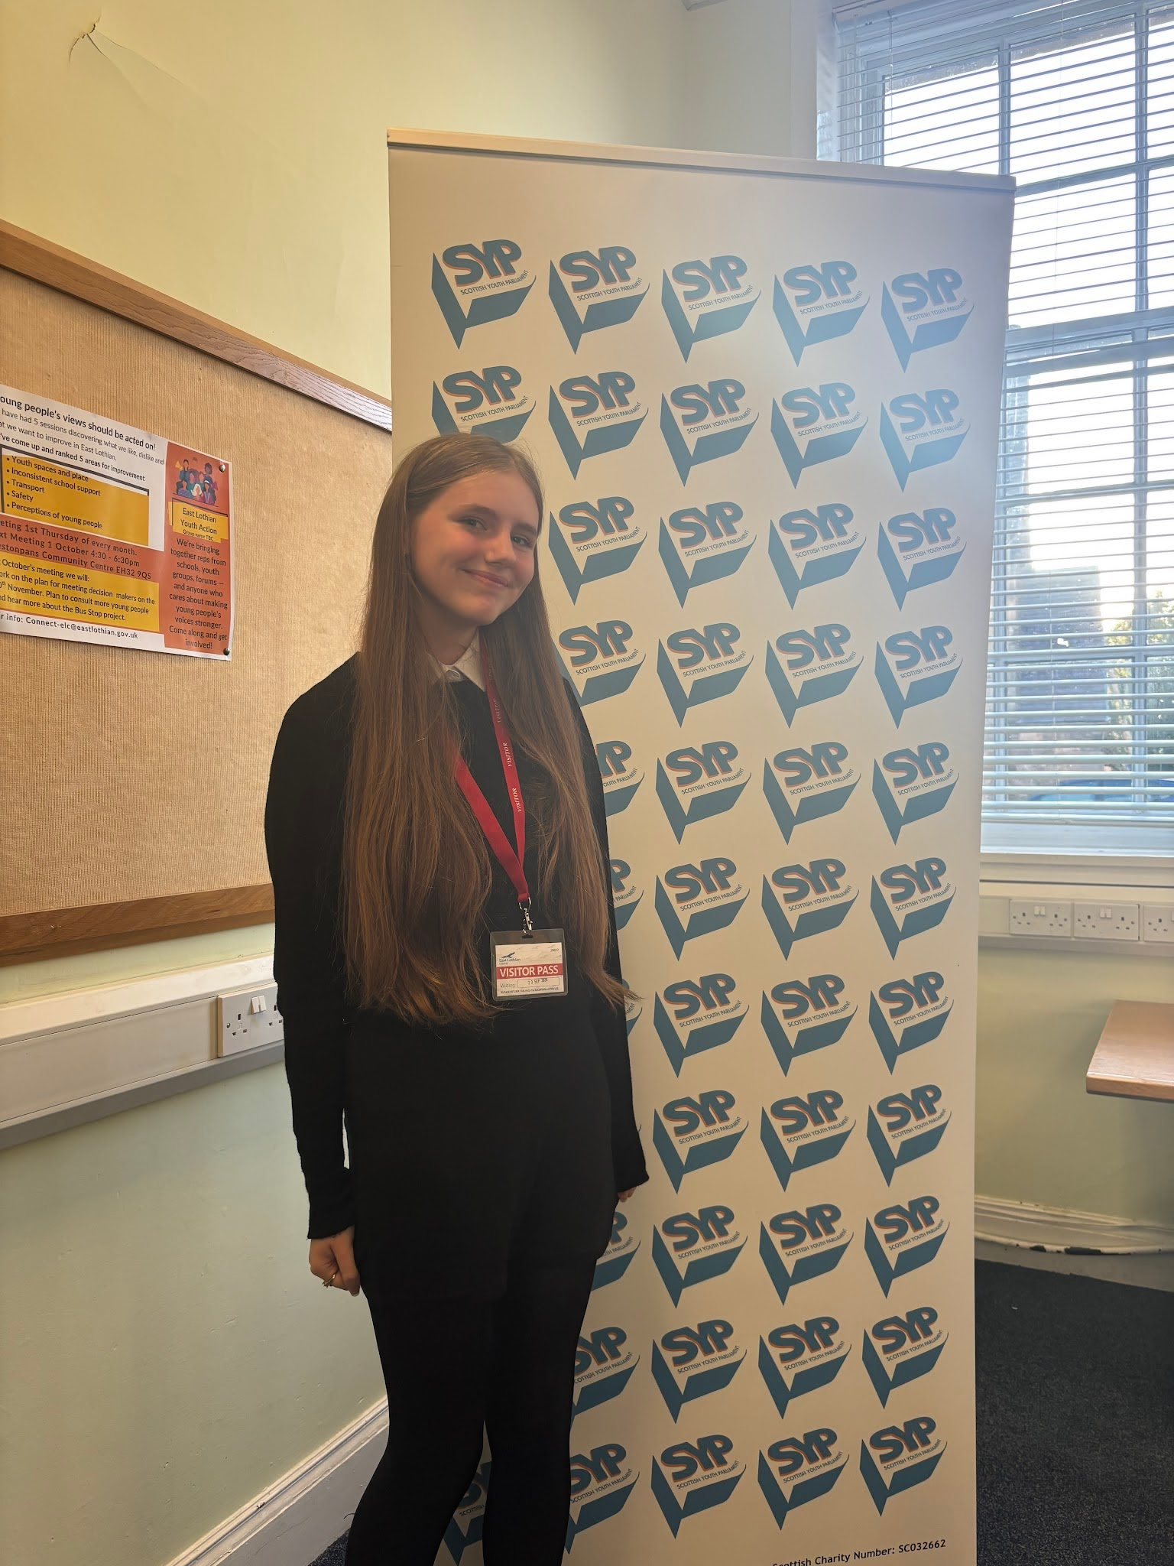
Personal Profile
Name:
Rhea-Leigh Hardie
Ways to contact me:
An Edinburgh Eastern Musselburgh and Tranent candidate with with a passion for change!
Bio:
I’m friendly and approachable please come and speak to me at election events, school inputs and campaign activities.
Or contact me on Instagram: rhea_msyp
Goals:
Less barriers in education
More youth spaces
More mental health support in schools
Who inspires me?
Who inspires me is my youth worker, my sister and my friends! They have helped me come this far and I couldn't of done it without them!

Slide 3
What are my key issues?
Health and Wellbeing
Equality
Education
I want to help young people understand and get help for their mental health and wellbeing.
I want to ensure equality all over the constituency and that no one is discriminated against.
I want to make sure Education is accessible and high quality for all learners.

