Slide 1

MSYP Elect Presentation
By Páidi Friel

Slide 2
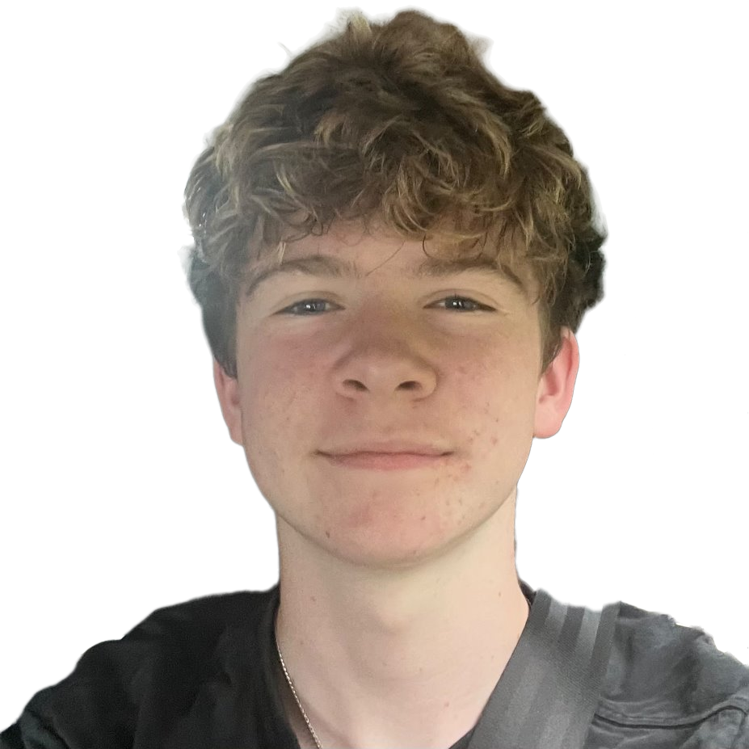
Why I want to run
I am very interested in the way the Scottish Youth Parliament works
I really want to help young people in Scotland get their voices heard
I want to get involved in Scottish politics when I'm older
I enjoy public speaking and sharing my opinions
Me and my friends don’t think that young people are represented enough in politics

Slide 3
Why people should vote for me
I can speak confidently
I have good communication skills
I will talk to young people in all year groups to see what they want
I will try my best at everything I do
I am reliable and responsible
I am very passionate about helping young people
I will treat everyone's ideas equally and take them on board.

