Slide 1
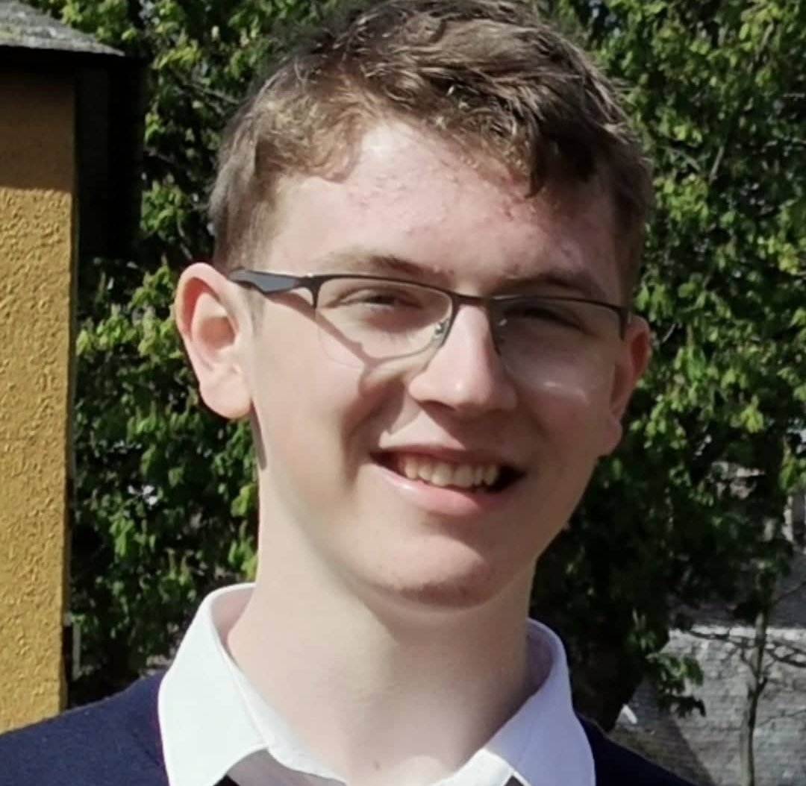
Oliver Massey for MSYP

Slide 2
Why I would like to become MSYP
I would like to become a MSYP for East Lothian in order to ensure the voices of young people are heard in government. I believe that making sure that the views of young people are fairly represented in Parliament is of the utmost importance and I hope that as an MSYP I can inspire young people across East Lothian to reach out and stand up for their beliefs.
I am passionate about the many injustices which continue to mar people's lives and wish to use the influence of the Scottish Youth Parliament to make a meaningful impact on people's lives.
Becoming an MSYP would provide an amazing opportunity to work with other young people from all across Scotland to help create a positive future for us all, and I look forward to meeting with young people in my constituency and raising their voices in decisions which affect all of us.

Slide 3
How will I consult with young people in my area?
As an MSYP I will be easily reachable and active on major social media platforms including Instagram and Twitter. This way I will be sure to ask my constituents about the issues that matter to them by regularly posting online to communicate directly with those who I will hopefully be representing and also conducting surveys on a wide variety of issues affecting them. I will also be contactable through public social media and invite young people to reach out to me and I promise that I will respond to any query or complaint however small it may seem.
In addition, I will hold regular drop-in sessions both online and in person in which I can meet with constituents and discuss issues face-to-face. I will endeavour to speak directly to people who will be affected by the governments actions and ultimately ensure the will of my constituents is represented in parliament.

Slide 4
Why should you vote for me?
I believe it is the job of an MSYP to always put the interests of their constituents first and make sure to listen to them regardless of any differing beliefs in order to act as effective representation.
If elected I will act on behalf of my constituents, raise their concerns to parliament and shall hold myself accountable by being reachable both online and in person.
I promise to always listen to the concerns of my constituents, however small or insignificant they may seem, and remain open minded when met with contrasting views.
There are innumerable problems continuing to mar our society, and I care deeply for all those wronged by injustices. For example: the continued war on drugs only hurts the most disadvantaged in society and fails to address the problems caused by drugs; appalling levels of poverty remain unaddressed; democracy is threatened by restrictions on peaceful protest and civil rights of marginalised groups are jeopardized.
As an MSYP I shall work with the Scottish Youth Parliament in order to eliminate the institutionalised barriers preventing people from realising their potential. I shall make it my duty to communicate directly with those who are impacted the most by the government's actions.

