Slide 1
Alexander Zlatev: About me and my Views

Slide 2
Justice

Slide 3
My stance on Justice is a strong one as for me a good justice system will be an effective tool to ensure young people’s safety. When talking about justice I am referring to both the Scottish judiciary system and the smaller justice systems such as school punishments. Despite all the amazing progress Scotland has made I think we lack in terms of effective justice which prevents us from truly protecting young people.
I advocate for the removal of the “not proven” as it leads to a lot of miscarriages in justice – 1 in 5 cases of sexual crimes in Scotland get the “not proven” verdict.
Although I am a firm-believer that alternatives to prison are an option this shouldn’t apply for sexual crimes – especially against people. The most common penalties for sexual assault convictions are community payback orders and prison sentences. It is vital that we try to impose harsher punishments for such offences and implement a better educational system in order to prevent such behaviour and teach boys how to be decent men from a young age. Sexual assault had been on the upward trend since 2011-12, having increased by 76% between then and 2018-2019. To prevent such horrible acts we must show that they will not be tolerated and that the consequences would be most severe.
We should also address justice in schools or the lack of it, in order to act in their pupils’ best interests many institutions overlook awful behavioural patterns which include bullying and often hateful remarks. From my observations casual hate speech and frankly offensive jokes are often perceived as normal and meaningless – because kids will be kids. This also applies to casual sexual remarks which are overlooked. Bullying is also an issue because although low, the instances of it are rarely punished due to the lack of severe consequences when it comes to young people’s misconducts. In order to teach young people what’s right and wrong we must show them that there are consequences.

Slide 4
Rights and Equality

Slide 5
The youth of Scotland should have an understanding of their own rights and an incentive to take action to defend the rights of others as well as their own.
Apart from being safe all young people must feel included. This should also include the political life of the country which although open to many young people is still rather vague. I believe that the lack of transparency regarding young people’s futures in recent years has been going against young people’s right to be informed.
Furthermore, equal treatment and safety are key factors in a young person’s well-being however those rights are often denied to people due to characteristics out of their control. According to a Plan International UK survey of more than 1000 girls and young women aged 14-21 feel like their opinions are overlooked and they are fed up with messages of false female empowerment. A total of 60% of girls felt that males are treated better than females in the UK, and 57% said they had been in a situation where they believe they would have got better treatment if they were a boy. This is worrying as it shows that although on paper we are equal some of us are MORE equal.
Safety is a right denied to many young people as well. Due to our lack of freedoms such as the second amendment and the legal status of pepper spray and knives young people have no real way to fend for themselves. If put in a situation where self-defence would be their only option young people are practically helpless. Tools like pepper spray – at least should be legalised to give a sense of security on the streets with some young people (like myself) lack.
For everyone to feel safe, included and respected is a must in a civil society and we should strive to achieve that.

Slide 6
Education

Slide 7
Education is perhaps the most influential topic as it affects all parts of life.
Transparency in education is the first important point that we as young people must address as such vital information was unclear to us for the longest time.
Furthermore, I believe that education is a right and it must be free. However we must also teach young people to not take such privileges for granted. Speaking from experience, I’ve observed people say things like “Why must I spend a penny on my notebook, when education in Scotland is free”, such entitlement is a bad lesson to teach young people as everyone should be encouraged to invest in their education if they can afford it. Therefore I think that basic necessities such as notebooks, folders and basic equipment should not be free.
I also believe that it is vital to help young people living in poverty have the same access to education and provide a more inclusive education for them as they are more likely to experience bullying and social pressure due to their financial status.
Scotland having the first LGBT inclusive educational system truly makes me smile however like many other systems – it is flawed. I believe that more emphasis should be put on online safety, the dangers of predatory behaviours in the gay community and sexual safety when it comes to same sex-relations. I also believe that it will be beneficial for such lessons to be taught by actual LGBT people who could share their own experiences.
Personally in recent years I have noticed a resurgence of hatred and bigotry even in progressive societies like Scotland, not long ago two men were brutally assaulted in Edinburgh simply because of their sexuality. Instances like this are what keeps me up at night. Hateful behaviours like homophobia aren’t natural, they are taught, the seed of bigotry takes roots at playgrounds and schools. The work in our schools is VITAL to prevent such incidents. My campaign will greatly emphasise a combination of educational methods which would help better teach the young people the importance of tolerance and how to eradicate bigotry.
Notes:
“Children accessing Free School Meals are 28% less likely to leave school with 5 A*-C GCSE grades than their wealthier peers.”
Information link: https://neu.org.uk/child-poverty-facts

Slide 8
Poverty and Income Inequality

Slide 9
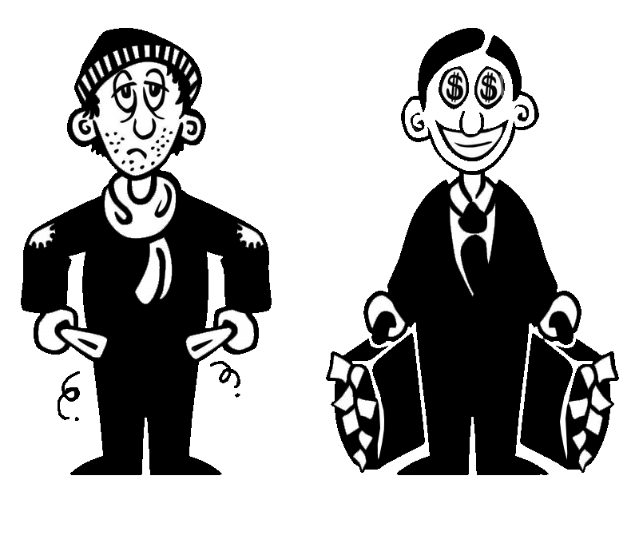
Fife has some of the poorest areas in Scotland, scoring 20% on the Scottish index of multiple deprivation as of 2020. Overall 26 per cent of children in Scotland were in poverty in 2019-20. This is a shocking statistic as It shows that ¼ of the overall youth population lives bellow the poverty line. With such alarming numbers it is vital that we take action to help support those of use who struggle financially. All of the main concerns of my campaign correlate to poverty and social inequality the lack of education leads to poverty and poverty leads to a lack of education and a lack of human rights, and equality.
Poverty creates barriers which prevent young people from accessing education. My goal as an MSYP would be to break those barriers and help people from more disadvantaged of backgrounds. People from more deprived backgrounds tend to achieve less as shown “Children accessing Free School Meals are 28% less likely to leave school with 5 A*-C GCSE grades than their wealthier peers.” Studies have also shown that children and adults living in poverty tend to struggle more with mental health, traumatology researches also show that children from disadvantaged backgrounds are much more likely to be bullied therefore developing trauma and demoralising them. My goal is to minimise those instances and help such people achieve.
The UK is one of the most unequal countries in Europe, statistics by the European union have shown that although the highest income area in Europe is in the UK(Central London), the UK also has nine out of the ten lowest income areas in Europe and one of, if not the highest income inequality gaps in the whole continent. This huge division of class and the fact that private education is favoured amongst the best of universities makes it harder from people from poorer backgrounds to climb the social ladder and escape poverty. The only way to attempt to solve that is to provide and environment that does not downgrade individuals on the basis of their social class and to direct our support towards these people.

Slide 10
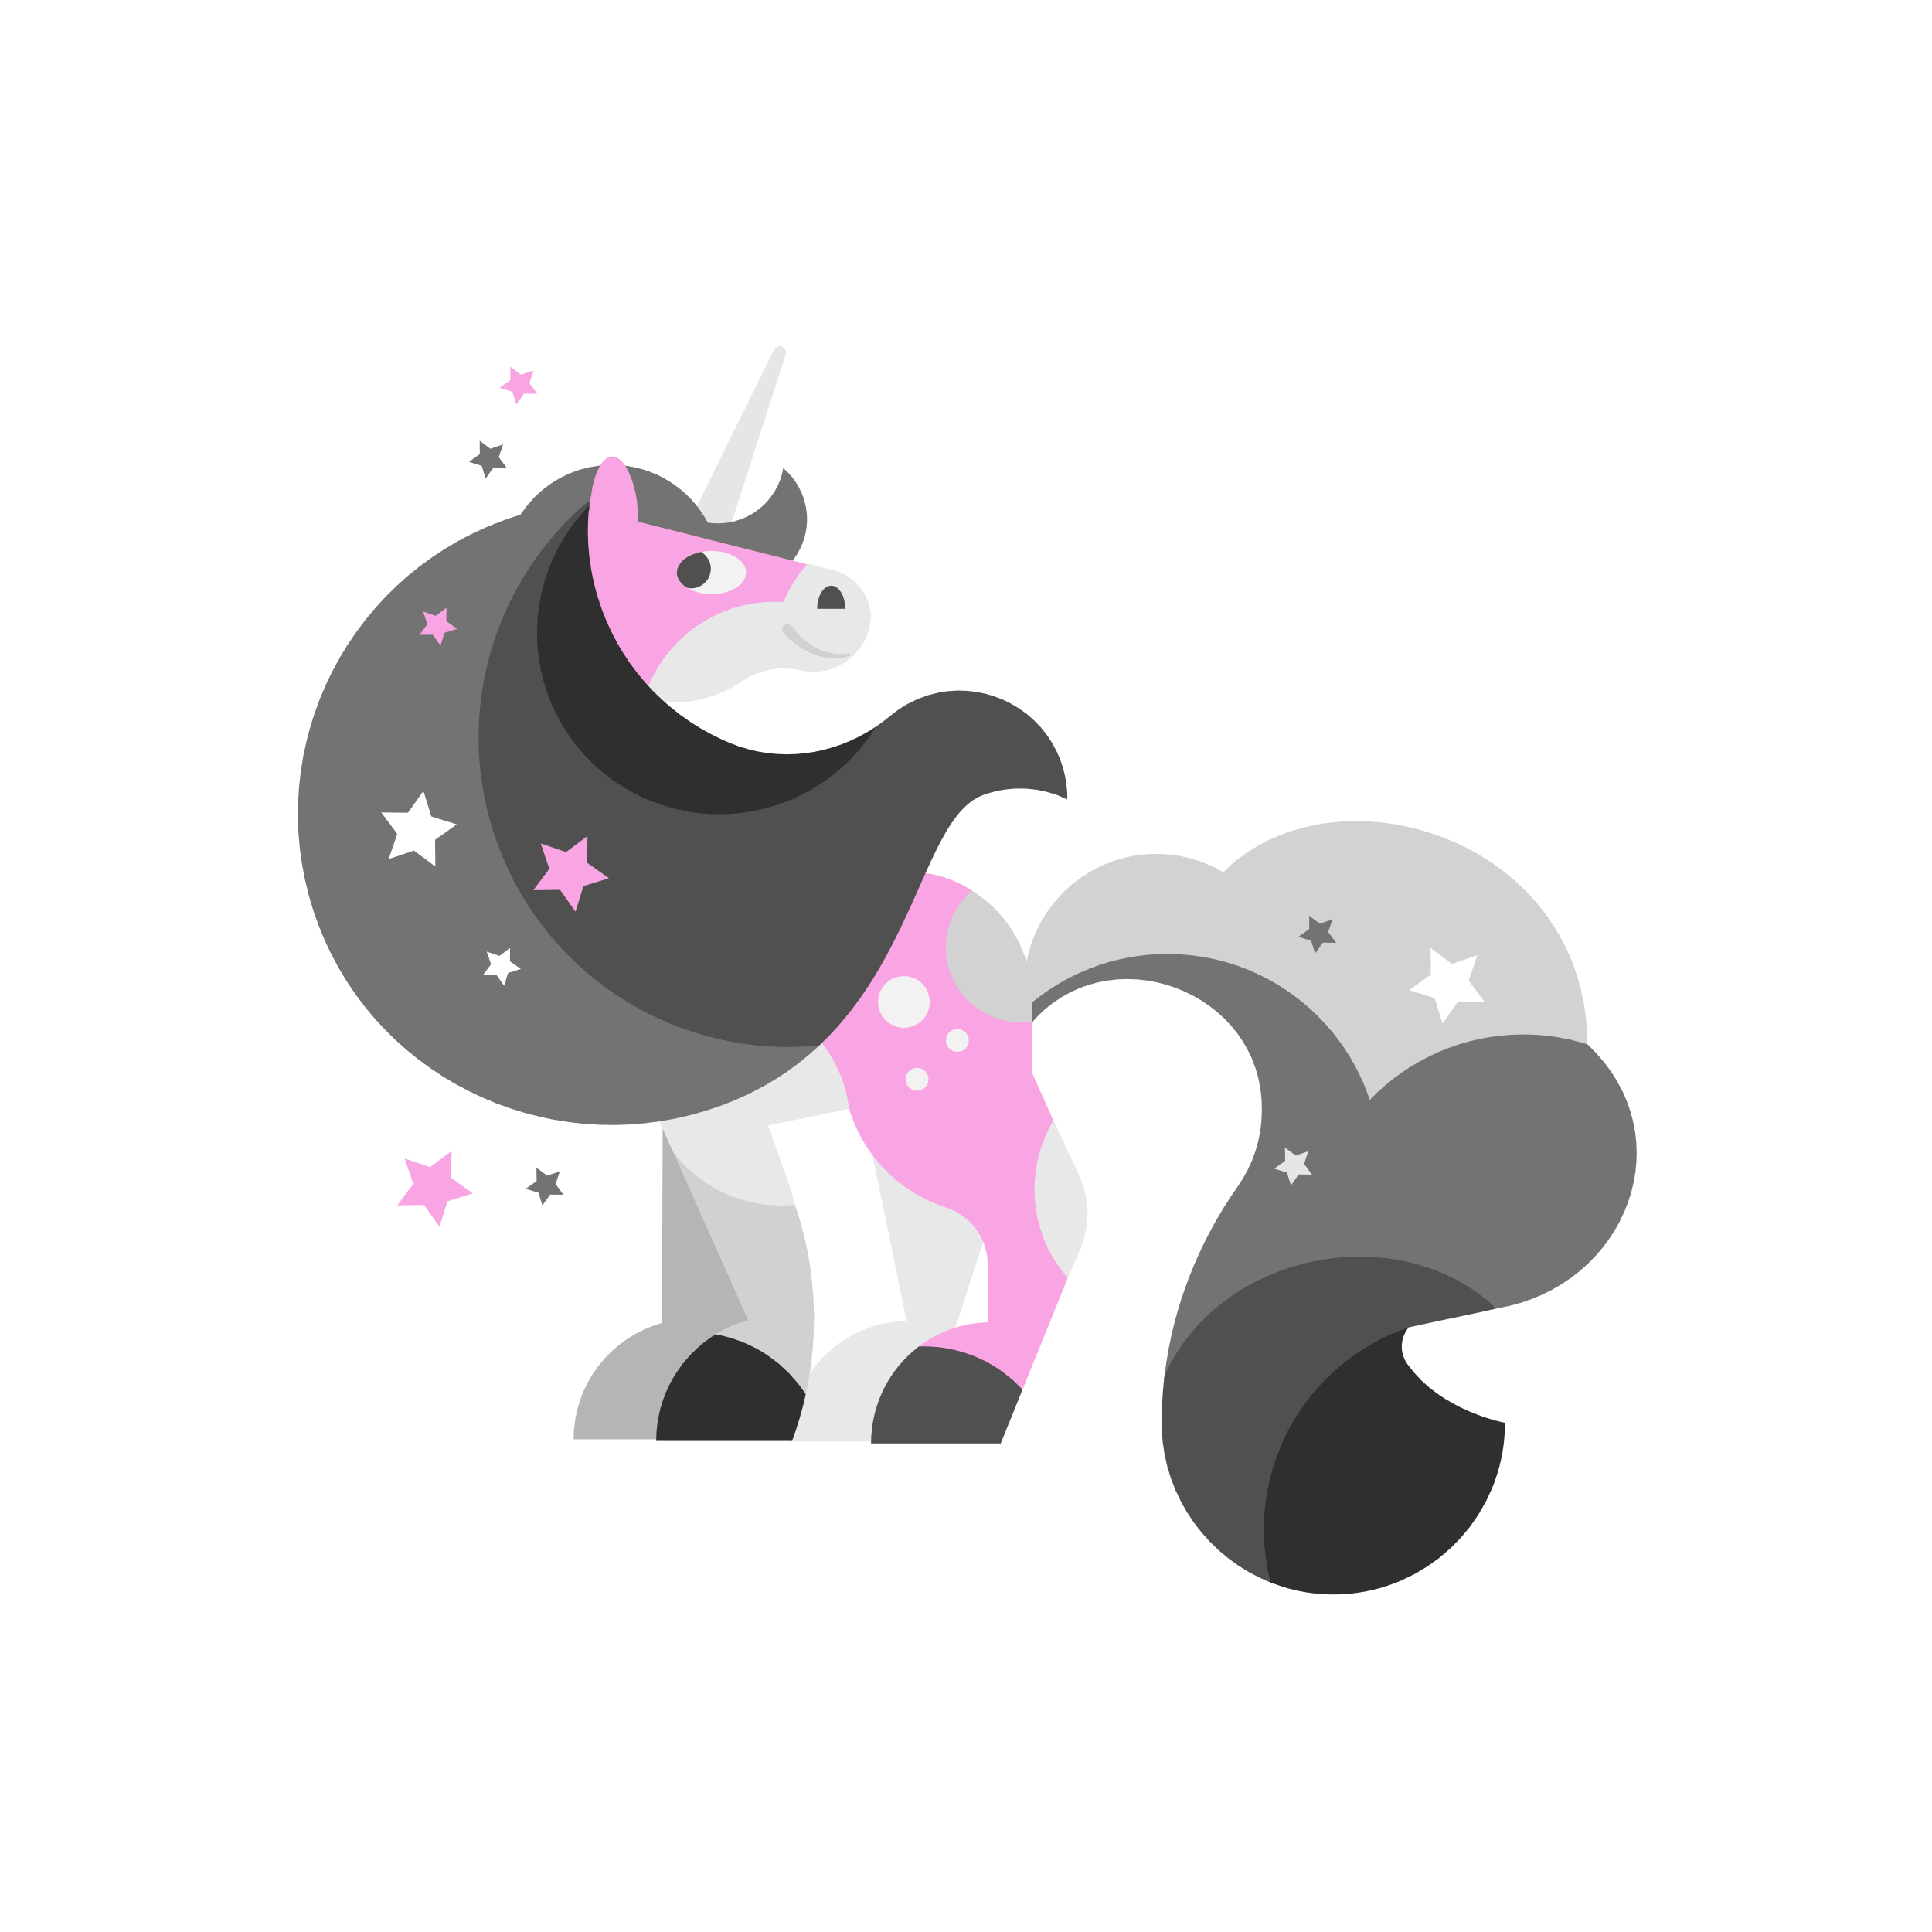
About
Me

Slide 11
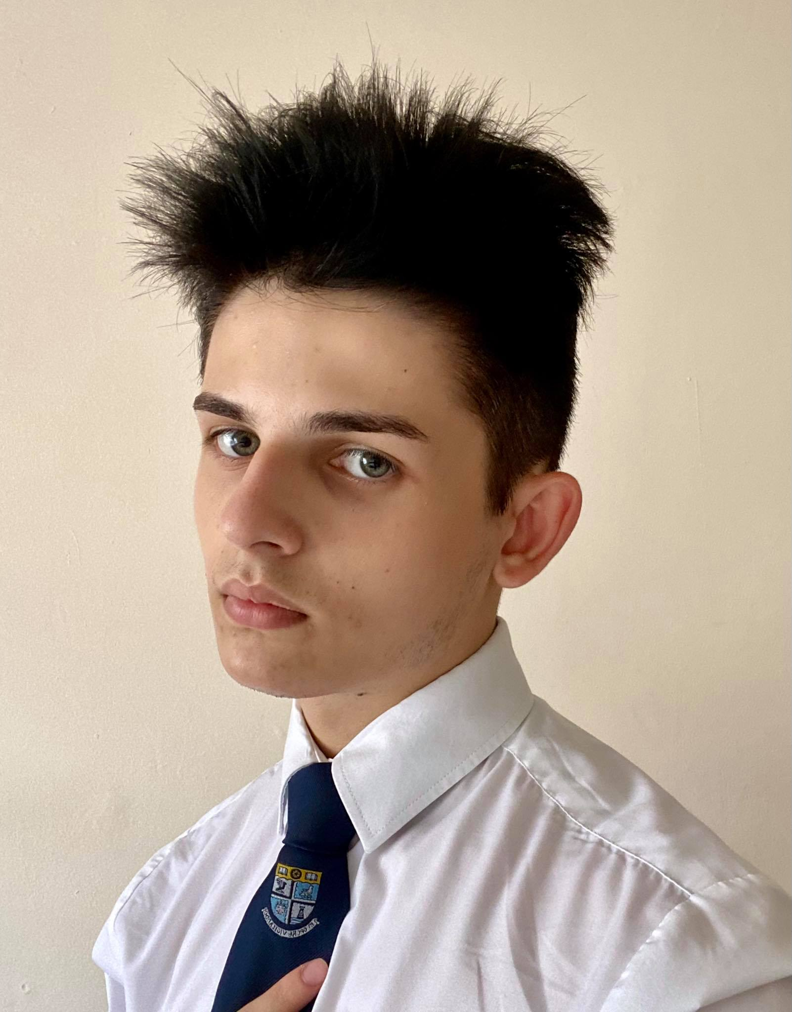
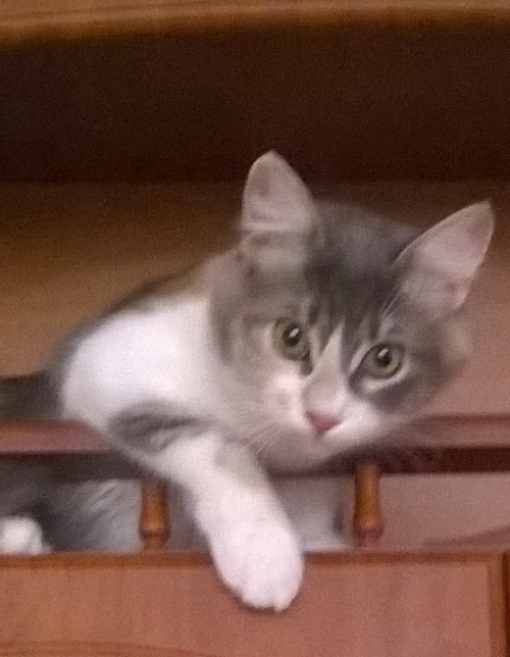
Salutations, potential voter.
My name is Alexander Zlatev. I was born in a small town next to the Black Sea, in Bulgaria. My native tongue is Bulgarian, evidently I speak English and I am learning French at the moment. Good tea and cat memes are the way to my heart. In my free time, I usually read, sleep or complain. I also used to draw before I gave it up due to my insecurity. I am a Scorpio meaning that I am expecting a “Happy Birthday” from everyone in November. I am either extremely extroverted or extremely introverted. I am also a man of order although my digital footprint suggests otherwise. I cannot define myself politically with a single word because recently my views have been changing, however what I can ensure is that I have the PEOPLE’s best interest at heart.
This is Uno, as the name suggests she is my first cat. (I was young, don’t laugh). She is five years old and her zodiac sign is Pisces. Her favourite hobbies are scratching the furniture, hissing at the seagulls outside and waking up at 3AM to bite my legs and wreak havoc. She loves losing toys, especially balls. Her overall count is 15 lost balls. She doesn’t like fish, and unfortunately she mainly eats packaged cat food which makes her obese but she just refuses to eat anything else. She hates going to the vet and loves biting him. Unlike my calm self, she is a vicious creature born of pure spite but regardless we love her. She is awfully clumsy and extremely vengeful just like me.
Currently she lives at my grandmother’s cat sanctuary as we were unable to take her due to her cowardly nature.
Alexander Zlatev
(He/Him)
My Cat(Uno)
(She/Her)

Slide 12
Salutations, potential voter.
My name is Alexander Zlatev. I was born in a small town next to the Black Sea, in Bulgaria. I moved to England in 2018 and after a year, we moved to Scotland. My native tongue is Bulgarian, evidently I speak English and I am learning French at the moment. Good tea and cat memes are the way to my heart. In my free time, I usually read, sleep or complain. I also used to draw before I gave it up due to my insecurity. I am a Scorpio meaning that I am expecting a “Happy Birthday” from everyone in November. I am either extremely extroverted or extremely introverted. I am also a man of order although my digital footprint suggests otherwise. I cannot define myself politically with a single word because recently my views have been changing, however what I can ensure is that I have the PEOPLE’s best interest at heart.
This is Uno, as the name suggests she is my first cat. (I was young, don’t laugh). She is five years old and her zodiac sign is Pisces. Her favourite hobbies are scratching the furniture, hissing at the seagulls outside and waking up at 3AM to bite my legs and wreak havoc. She loves losing toys, especially balls. Her overall count is 15 lost balls. She doesn’t like fish, and unfortunately she mainly eats packaged cat food which makes her obese but she just refuses to eat anything else. She hates going to the vet and loves biting him. Unlike my calm self, she is a vicious creature born of pure spite but regardless we love her. She is awfully clumsy and extremely vengeful just like me.
Currently she lives at my grandmother’s cat sanctuary as we were unable to take her due to her cowardly nature.
Alexander Zlatev
(He/Him)
My Cat(Uno)
(She/Her)

Slide 13
Salutations, potential voter.
My name is Alexander Zlatev. I was born in a small town next to the Black Sea, in Bulgaria. My native tongue is Bulgarian, evidently I speak English and I am learning French at the moment. Good tea and cat memes are the way to my heart. In my free time, I usually read, sleep or complain. I also used to draw before I gave it up due to my insecurity. I am a Scorpio meaning that I am expecting a “Happy Birthday” from everyone in November. I am either extremely extroverted or extremely introverted. I am also a man of order although my digital footprint suggests otherwise. I cannot define myself politically with a single word because recently my views have been changing, however what I can ensure is that I have the PEOPLE’s best interest at heart.
This is Uno, as the name suggests she is my first cat. (I was young, don’t laugh). She is five years old and her zodiac sign is Pisces. Her favourite hobbies are scratching the furniture, hissing at the seagulls outside and waking up at 3AM to bite my legs and wreak havoc. She loves losing toys, especially balls. Her overall count is 15 lost balls. She doesn’t like fish, and unfortunately she mainly eats packaged cat food which makes her obese but she just refuses to eat anything else. She hates going to the vet and loves biting him. Unlike my calm self, she is a vicious creature born of pure spite but regardless we love her. She is awfully clumsy and extremely vengeful just like me.
Currently she lives at my grandmother’s cat sanctuary as we were unable to take her due to her cowardly nature.
Alexander Zlatev
(He/Him)
My Cat(Uno)
(She/Her)

Slide 14
Salutations, potential voter.
My name is Alexander Zlatev. I was born in a small town next to the Black Sea, in Bulgaria. My native tongue is Bulgarian, evidently I speak English and I am learning French at the moment. Good tea and cat memes are the way to my heart. In my free time, I usually read, sleep or complain. I also used to draw before I gave it up due to my insecurity. I am a Scorpio meaning that I am expecting a “Happy Birthday” from everyone in November. I am either extremely extroverted or extremely introverted. I am also a man of order although my digital footprint suggests otherwise. I cannot define myself politically with a single word because recently my views have been changing, however what I can ensure is that I have the PEOPLE’s best interest at heart.
This is Uno, as the name suggests she is my first cat. (I was young, don’t laugh). She is five years old and her zodiac sign is Pisces. Her favourite hobbies are scratching the furniture, hissing at the seagulls outside and waking up at 3AM to bite my legs and wreak havoc. She loves losing toys, especially balls. Her overall count is 15 lost balls. She doesn’t like fish, and unfortunately she mainly eats packaged cat food which makes her obese but she just refuses to eat anything else. She hates going to the vet and loves biting him. Unlike my calm self, she is a vicious creature born of pure spite but regardless we love her. She is awfully clumsy and extremely vengeful just like me.
Currently she lives at my grandmother’s cat sanctuary as we were unable to take her due to her cowardly nature.
Alexander Zlatev
(He/Him)
My Cat(Uno)
(She/Her)

