Slide 1
Emma Tierney 4 SYP. Manifesto:
Hi, My name is Emma Tierney and Im running to be a member of the Scottish Youth Parliament (SYP) and this is my presentation.
Why would I like to be apart of the SYP?
I would like to be apart of the Scottish youth parliament because, I care dearly about the thoughts and opinions from the people of our country including the youth, and I believe that I am capable of giving Scotland a brighter future!
Poverty and income inequality.
Every child should have a breakfast.
Eliminate hygeine poverty.
How would I fix these?
In order to fix these issues I would get alot more families involved with charities and food banks and set up plans so that all children can have access to warm meals and hygiene products like deodorant, sanitary products, shampoos and conditioners etc.

Slide 2
Manifestos: Emma Tierney 4 SYP
Health and wellbeing.
Mental health support for all youth
Safe spaces for girls
Acsess for sport
How would I fix these?
In order to fix these issues I would make sure all youths had access to mental health support in and outside of school by setting up counselling sessions and online websites. To create safe spaces for girls I would campaign for designated areas to be created in with school and in every environment a girl is apart of in order for girls to go and feel supported and safe. To get rid of this issue I would hold more campaigns to fund sport access I would organise sport fundraising events and reach out to local businesses for sponsorship
Culture and media.
Embrace Scottish culture
Promote safe social media usage for all youths
Educate the youth about fake news
How would I fix these?
To embrace Scottish culture I would encourage people to immerse in Scottish traditions and hold community celebrations and try to inspire people to eat more traditional dishes. To help promote safe social media usage I would open communication, set practical boundaries and teach digital resilience. To help educate the youth about false news I would influence them to pause and question everything they are seeing online before spreading it and believing it.

Slide 3
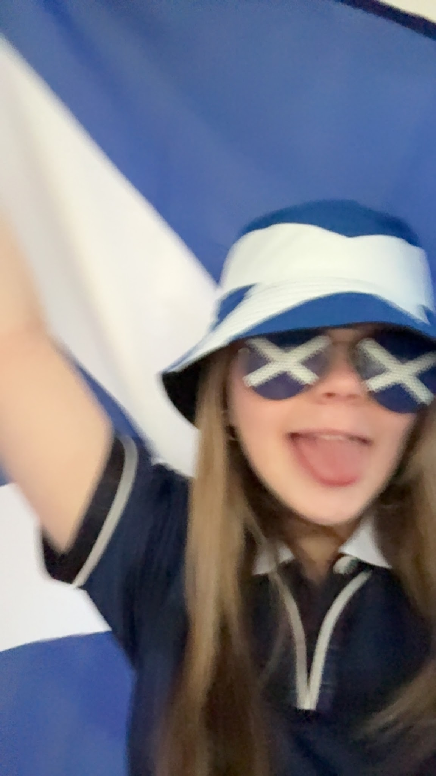
Make Clackmannanshire great again!
Vote Emma Tierney for better future!
Thanks for watching!

