Slide 1
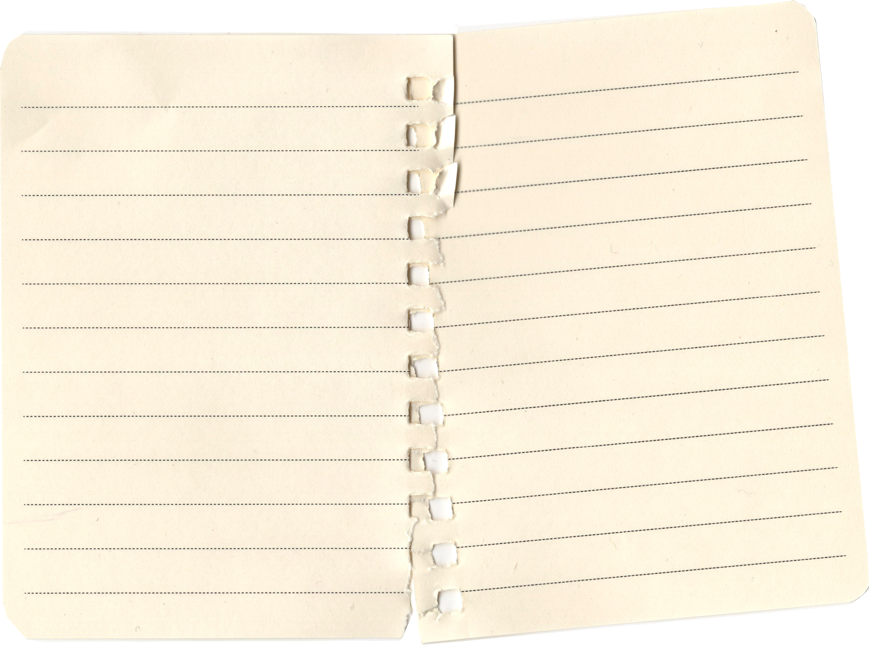

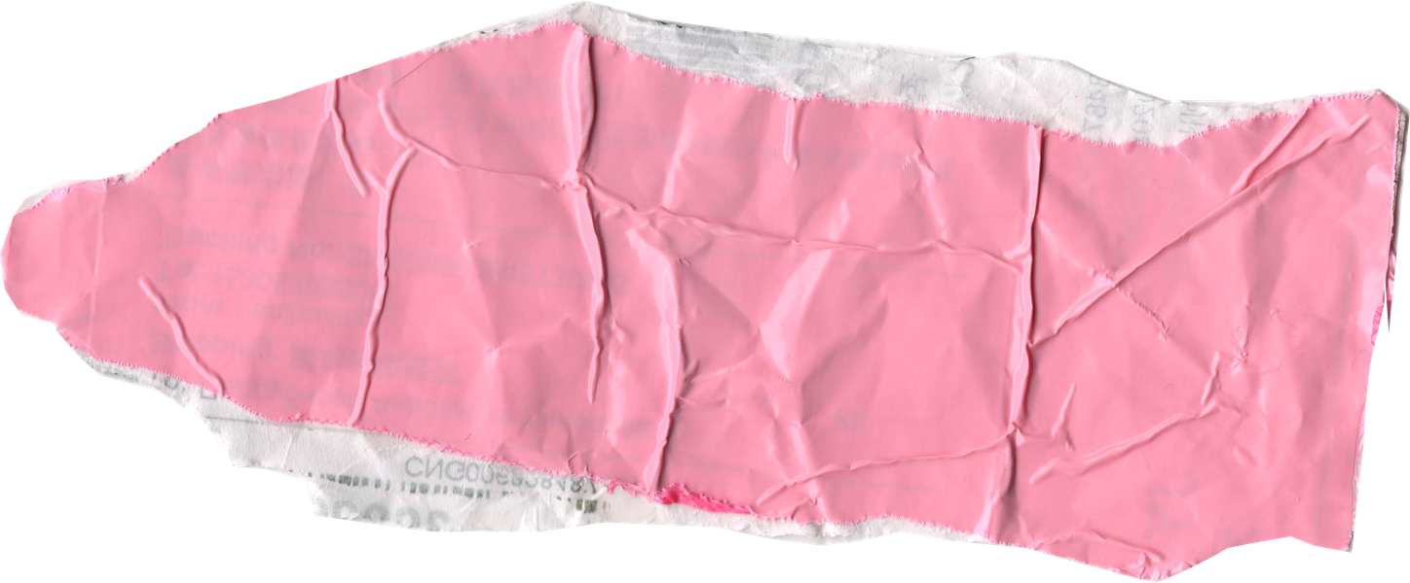


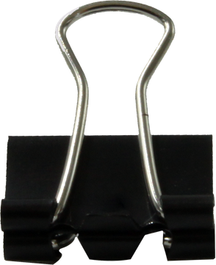
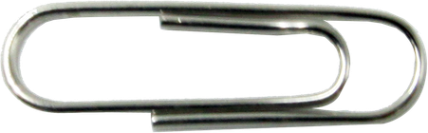

F
M
or Clackmananshire
y Vision
HEALTH & WELLBEING
Improving access to mental health support for young people and raising awareness to break stigma, so every young Scot can thrive and reach their full potential.
Raise young people's priorities with Clackmannanshire Council and other decision-makers.
Campaign for young people to have a greater say in how funding for youth services is spent.
I would make listening to young people a key part of my role as an MSYP.
Listen to young people about their experiences accessing GPs, mental-health support and other services including schools to see what needs to be achieved. I will take this information to the council and advocate for more sources of support.
I will push to promote opportunities to get active through schools and local clubs.
🏊‍♀️ Make young people aware of opportunities including sport, health and youth activities and create more alongside them.
Push for support that is accessible, inclusive and easy to understand
Any questions or requests please feel free to contact me
TIKTOK: nathi_for_msyp INSTAGRAM: nathi_for_msyp

Slide 2





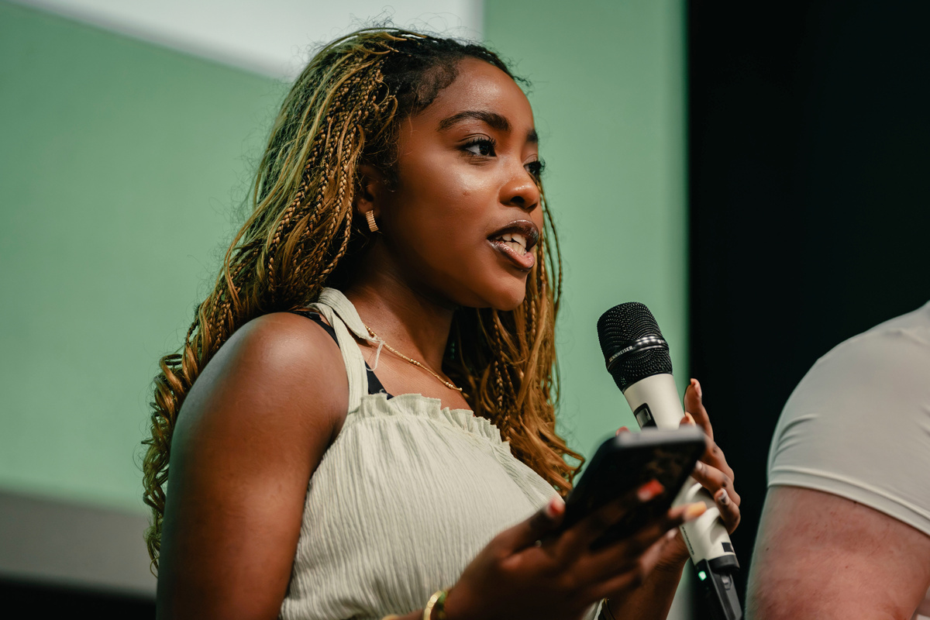



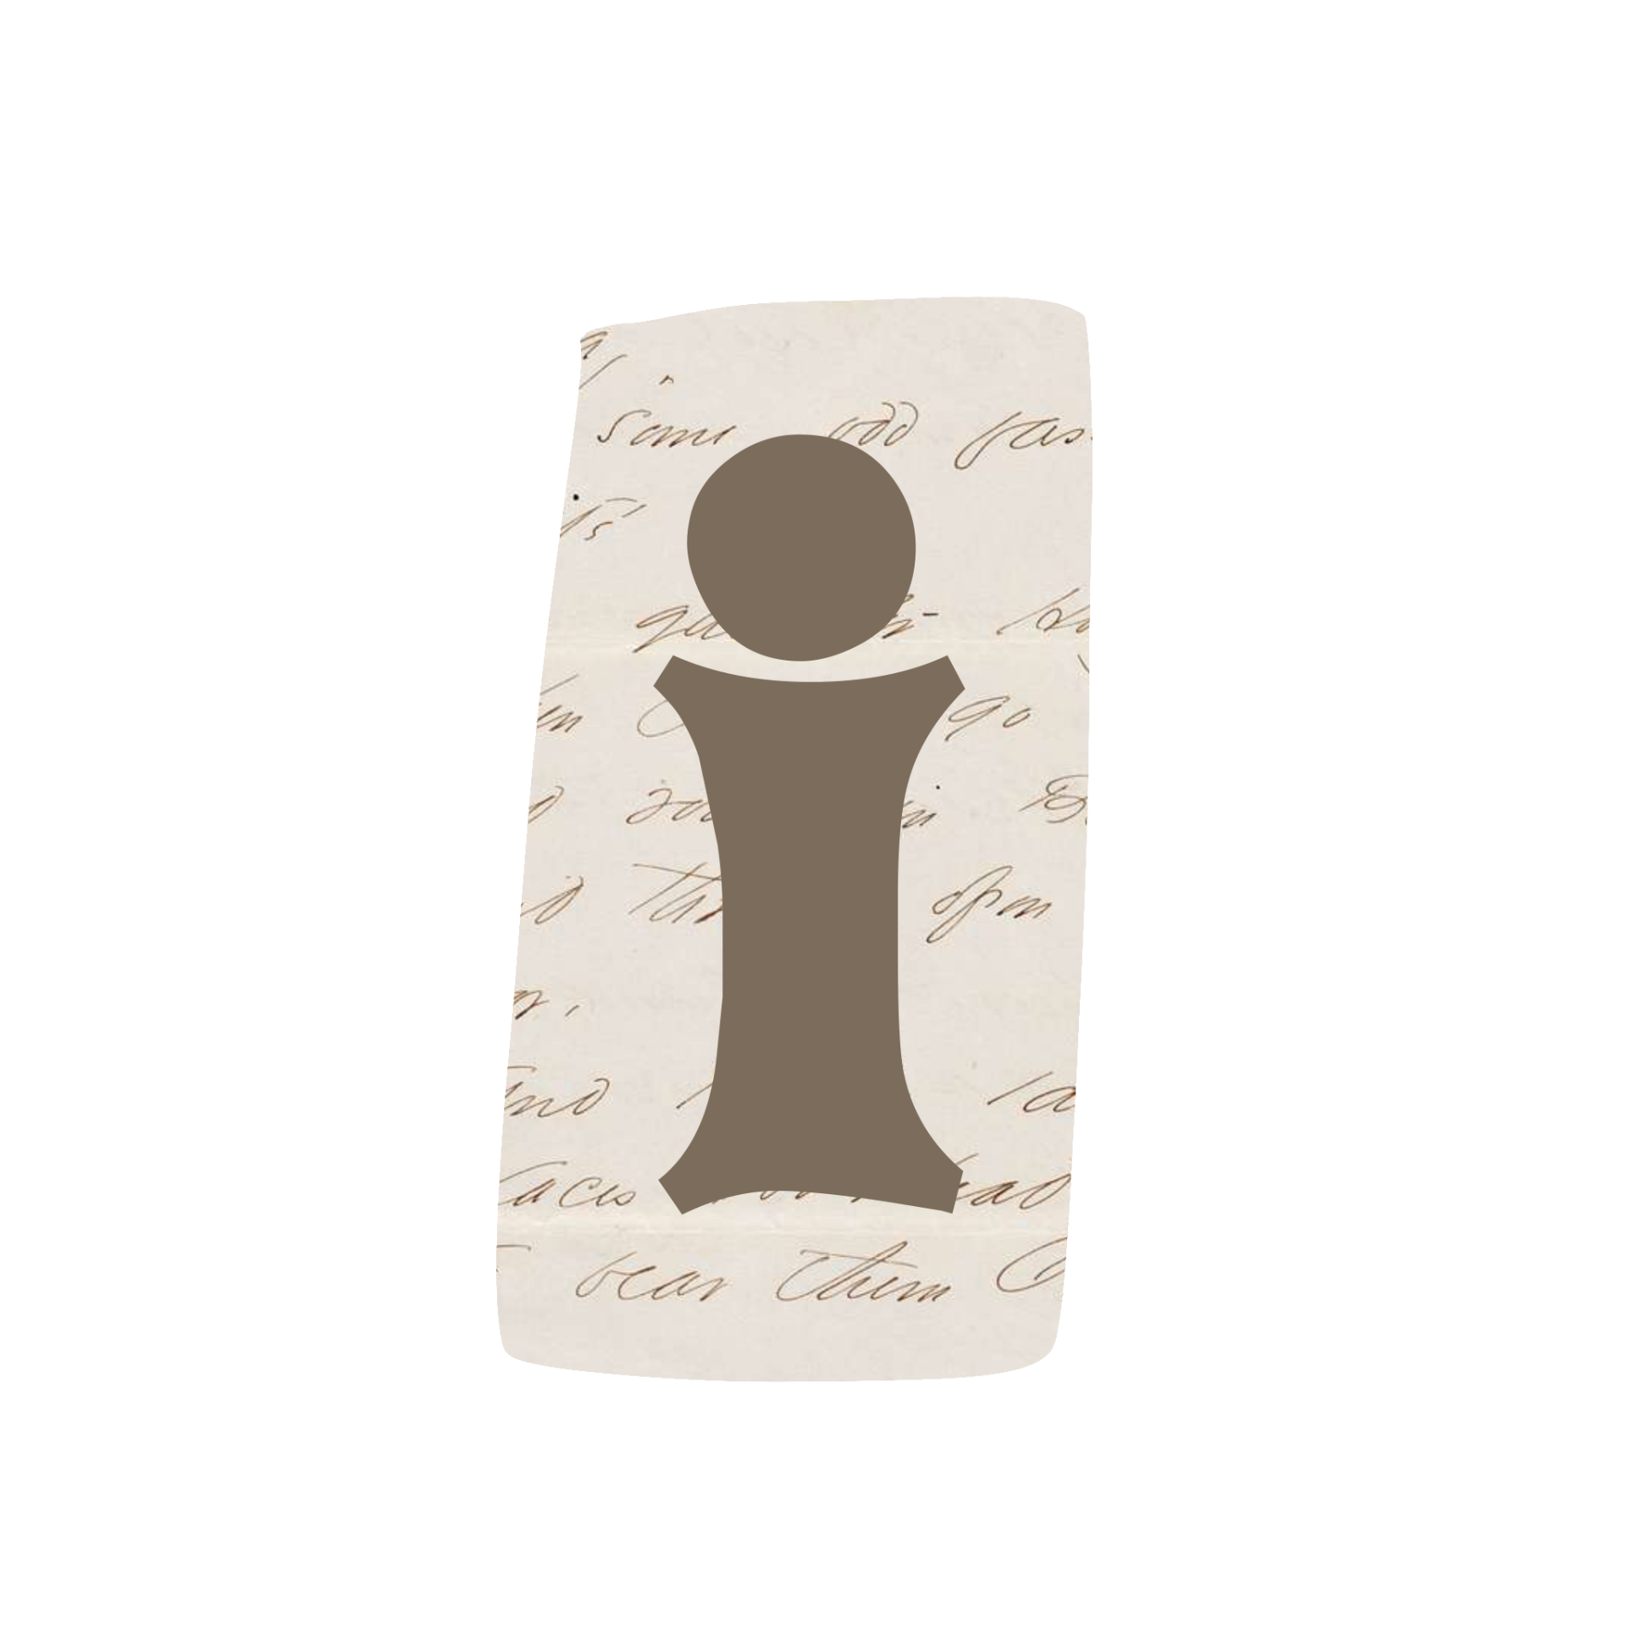




M
y Aim
EDUCATION
Listen to pupils and educators about what they think needs to change in their schools.
Support local organisations to make young people's voices part of funding decisions. For example more recycling bins in school.
Advocating for sustainable environmental policies and fighting for better education and employment opportunities, ensuring a fair and successful future for Scotland's youth.
Make sure pupils with additional support needs can access education and opportunities
Education isn't only about exam results. It's about having the support, opportunities, skills and confidence to decide what comes next.

Slide 3

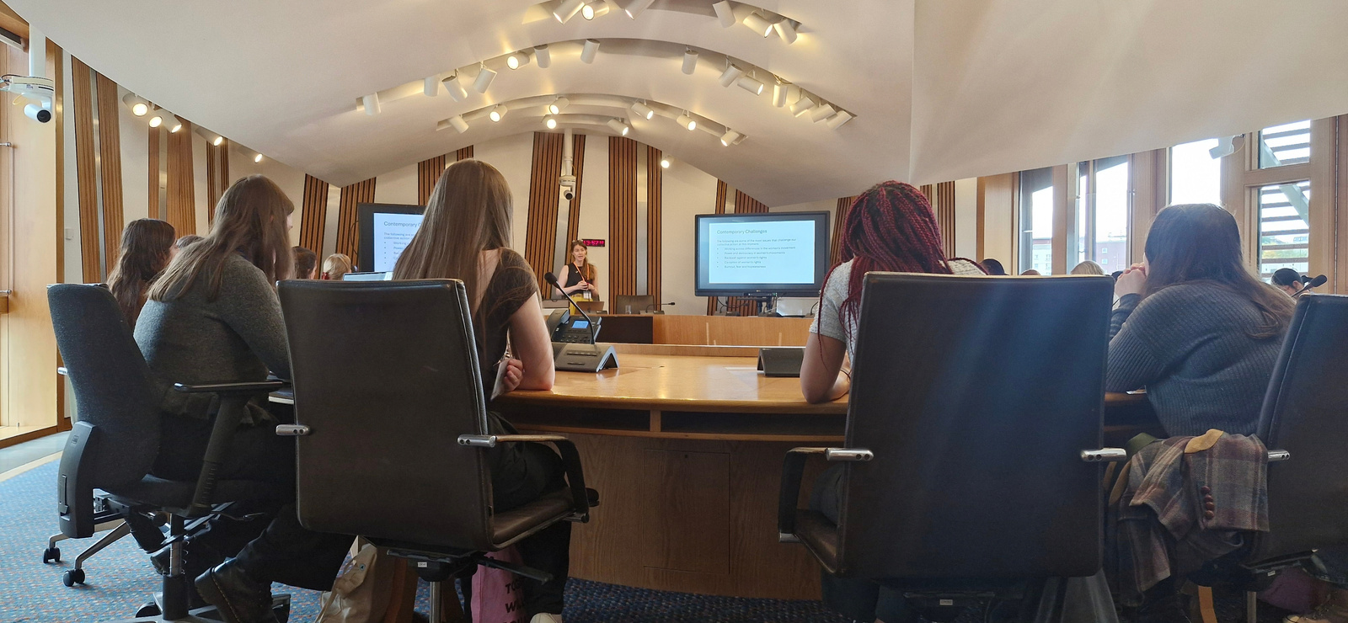
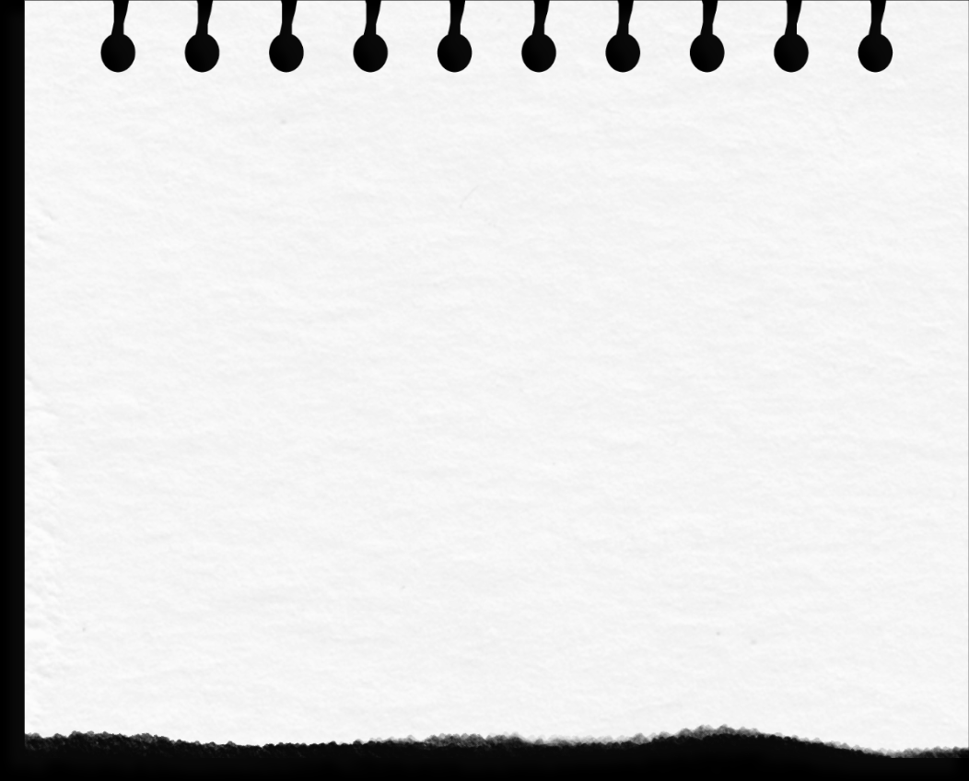




L
et's
C
hange
EQUALITY & INCLUSION
Championing diverse youth voices across Scotland, ensuring every young person — regardless
of background — is heard, valued, and represented in our parliament.
I would not only hear from those already involved in youth groups or leadership, but actively reach young people who may not usually feel confident speaking up.
I would use social media, anonymous surveys, polls and face-to-face conversations in schools, youth groups and community spaces.
I would make these opportunities as accessible as possible by offering different ways to share views, using clear and easy-to-understand language, and considering accessibility needs, including those of disabled and neurodivergent young people.
I would also make sure young people who have limited access to technology have other ways to participate.
I would welcome opinions that challenge my own because good representation means listening, not assuming.
I want young people to see their voices being listened to, represented and turned into action.
Any questions or requests please feel free to contact me
TIKTOK: nathi_for_msyp INSTAGRAM: nathi_for_msyp

