Slide 1
MSYP Campaign presentation
By Ishika Roy Chowdhury

Slide 2
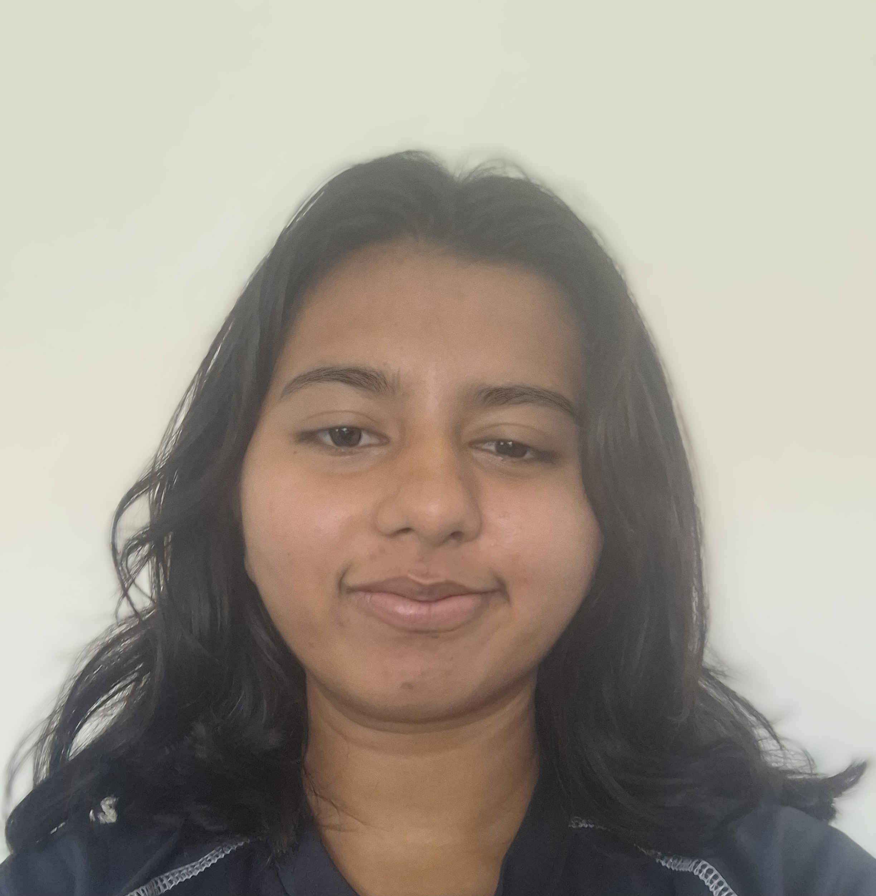
Introduction
My name is Ishika Roy Chowdhury
I am standing as an candidate for the election of Dundee City MSYP.
I want to bring major changes that will be good for young individuals of the city and create a safe environment.
I hope that I shall be able to bring awareness for certain issues that should be regarded with importance.

Slide 3
My main focus
For my campaign, one of the issues I want to change as an candidate is the equalities certain groups of young individuals are lacking. This equalities root from opportunities, such as going to a trip or even signing up for an event. I want to change that by including everyone and guiding the main value of respecting people around us.
Another issue I would like to change as an candidate, is regarding justice. When a terrible act occurs to an young individual, it can often silence them due to the consequences backfiring on them even though they are the victim, rather than holding the perpetrator responsible. I want to bring justice to the victims, allowing them to express their voice with confidence when they feel as though they are wronged for no reason at all.
A final issue I would want to make major change to is rights. Specifically holding the rights accountable for young individuals when they are being suppressed from it. I would want to bring more attention regarding the right to culture, the right to live and the right to education. Young individuals should be choosing a certain good pathway without any pressure or coercion.

