Slide 1
How can I help you?
Ava Broadley MSYP Candidate for EK

Slide 2
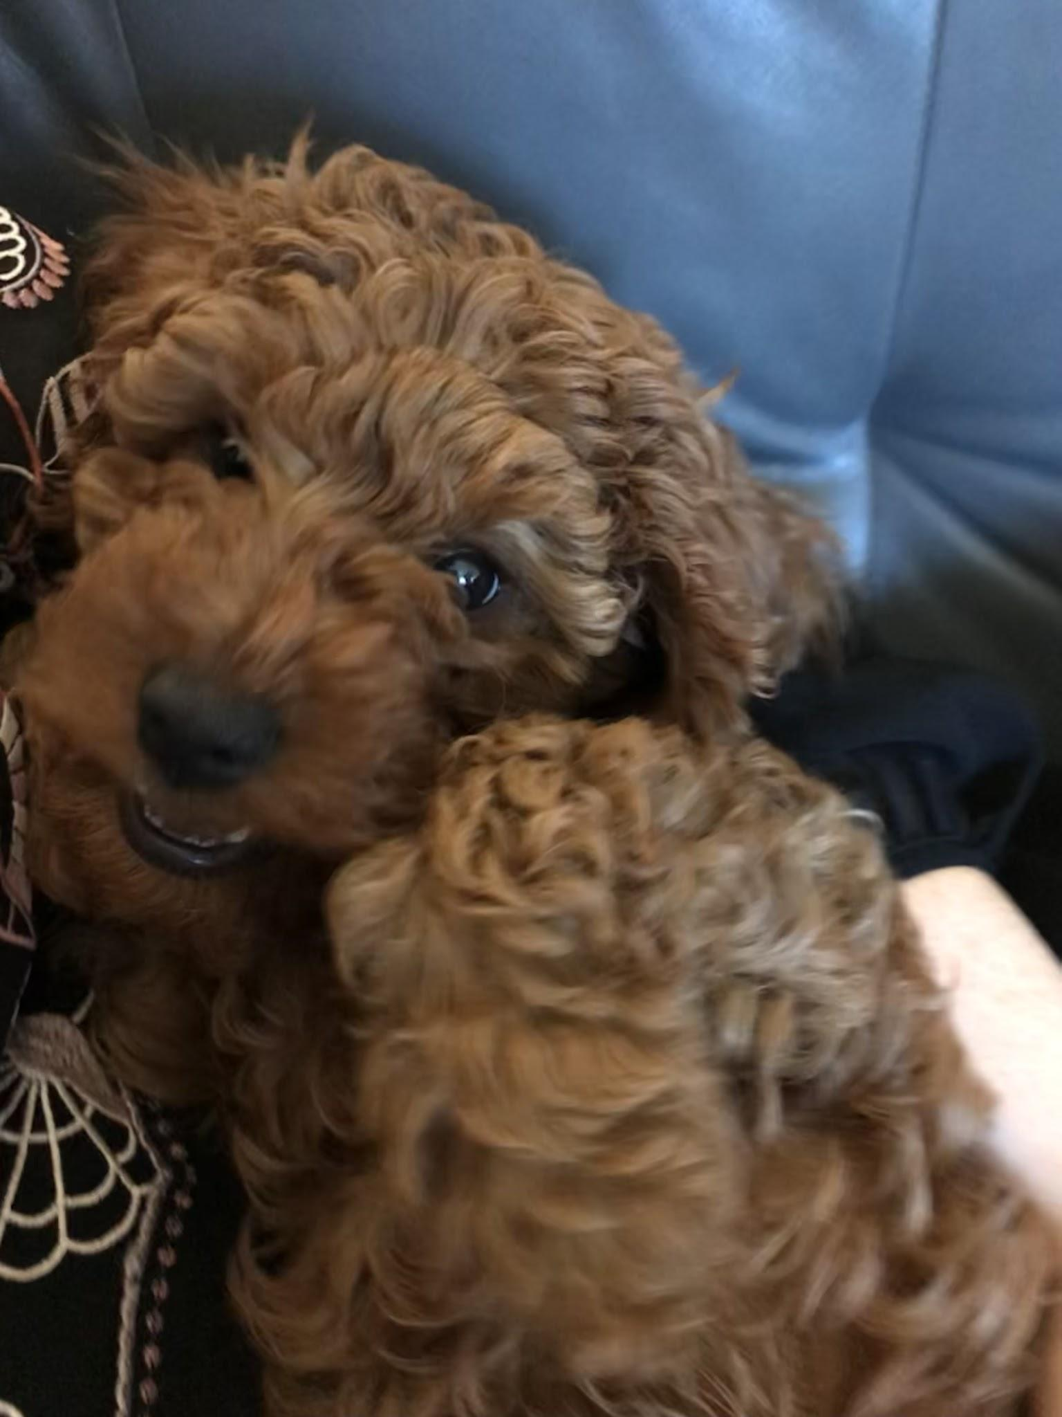
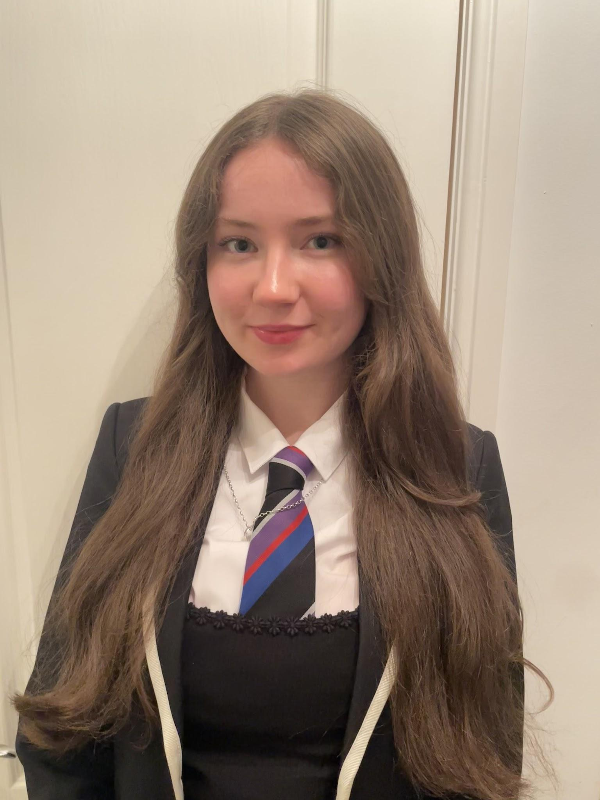
About Me! :)
I have a dog called Archie
——>
I’m a 17 year old pupil at St Andrew’s and St Brides
I’m a member of our school’s debate team
My favourite band is Arctic Monkeys 🪩
My favourite subjects are politics and spanish
I love art, makeup and music!

Slide 3
My Priorities as a candidate:
Our issues:
Littering and Fly-tipping within EK
Lack of employment opportunities
Underrepresentation for groups such as LGBTQ+ youth, young women and young people with disabilities
My solutions:
Education surrounding our environment and promoting local litter picking groups and awareness for respecting the upbringing of our youth in a clean, safe environment
Collaborate with local businesses to ensure job opportunities specifically for young people and re-introduce physical CVs
Promote programs and resources available for our underrepresented youth while ensuring they are providing effective support and publicise safe spaces within our community where young people know they can feel welcome

